Slide 1
MATH6077 – Discrete Mathematics
Week 05 - Number Theory

Slide 2

Divisibility and Modular Arithmetic

Slide 3
Introduction
Division of an integer by a positive integer produces a quotient and a remainder.
Working with these remainders leads to modular arithmetic, which plays an important role in mathematics and which is used throughout computer science.
Some important applications of modular arithmetic including generating pseudorandom numbers, assigning computer memory locations to files, constructing check digits, and encrypting messages

Slide 4
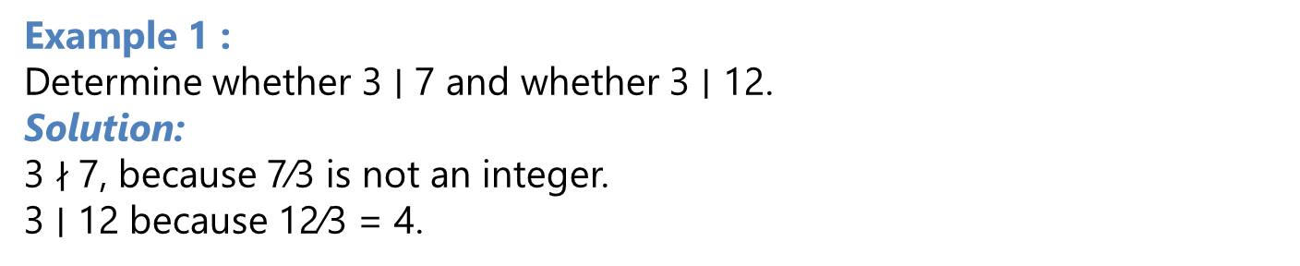
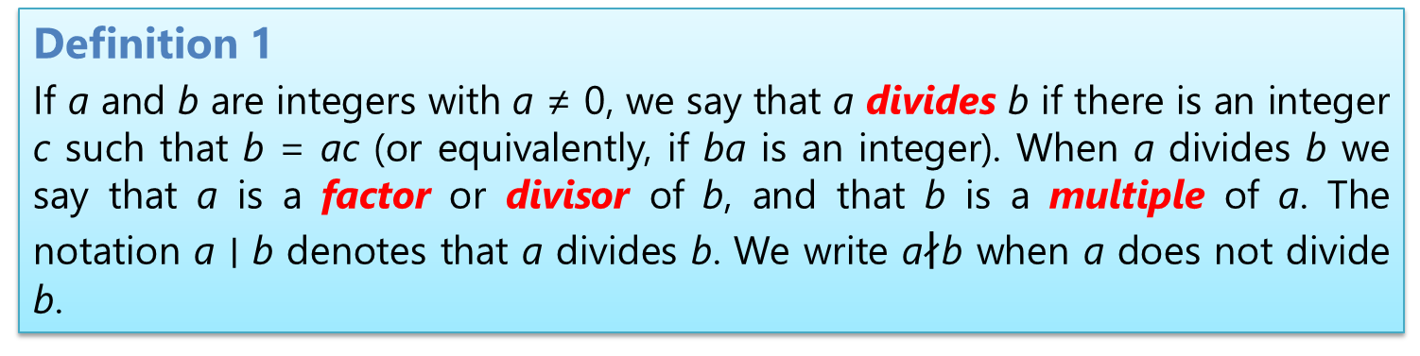
Division
Definition 1
If a and b are integers with a ≠ 0, we say that a divides b if there is an integer c such that b = ac (or equivalently, if ba is an integer). When a divides b we say that a is a factor or divisor of b, and that b is a multiple of a. The notation a ∣ b denotes that a divides b. We write a$∤$b when a does not divide b.
Example 1 :
Determine whether 3 ∣ 7 and whether 3 ∣ 12.
Solution:
3 $∤$7, because 7∕3 is not an integer.
3 ∣ 12 because 12∕3 = 4.

Slide 5
Division
Example 02 :
Let n and d be positive integers. How many positive integers not exceeding n are divisible by d?
Solution:
The positive integers divisible by d are all the integers of the form dk, where k is a positive integer.
Hence, the number of positive integers divisible by d that do not exceed n equals the number of integers k with 0 < dk ≤ n, or with 0 < k ≤ n∕d.
Therefore, there are ⌊n∕d⌋ positive integers not exceeding n that are divisible by d.

Slide 6
Division
Theorem 1 :
Let a, b, and c be integers, where a ≠ 0. Then
(i) if a ∣ b and a ∣ c, then a ∣ (b + c);
(ii) if a ∣ b, then a ∣ bc for all integers c;
(iii) if a ∣ b and b ∣ c, then a ∣ c.
Integers divisible by the positive integer d.

Slide 7
Division
Corollary 1
If a, b, and c are integers, where a ≠ 0, such that a ∣ b and a ∣ c, then a ∣ mb+nc whenever m and n are integers.
Proof:
We will give a direct proof.
By part (ii) of Theorem 1 we see that
a ∣ mb and a ∣ nc
whenever m and n are integers.
By part (i) of Theorem 1 it follows that a ∣ mb + nc.

Slide 8
The Division Algorithm
Theorem 2
THE DIVISION ALGORITHM Let a be an integer and d a positive integer. Then there are unique integers q and r, with 0 ≤ r < d, such that a = dq + r.
Definition 2
In the equality given in the division algorithm, d is called the divisor, a is called the dividend, q is called the quotient, and r is called the remainder. This notation is used to express the quotient and remainder:
q = a div d, r = a mod d.

Slide 9
The Division Algorithm
Example 1:
What are the quotient and remainder when 11 is divided by 11?
Solution:
We have 11 = 11 ⋅ 9 + 2.
Hence, the quotient when 11 is divided by 11 is
9 = 11 div 11,
and the remainder is
2 = 11 mod 11.

Slide 10
Modular Arithmetic
Definition 3:
If a and b are integers and m is a positive integer, then a is congruent to b modulo m if m divides a − b. We use the notation a ≡ b (mod m) to indicate that a is congruent to b modulo m. We say that a ≡ b (mod m) is a congruence and that m is its modulus (plural moduli). If a and b are not congruent modulo m, we write a ≢ b (mod m).
Theorem 3
Let a and b be integers, and let m be a positive integer. Then a ≡ b (mod m) if and only if a mod m = b mod m.

Slide 11
Modular Arithmetic
Example :
Determine whether 17 is congruent to 5 modulo 6 and whether 24 and 14 are congruent modulo 6.
Solution:
Because 6 divides 17 − 5 = 12, we see that 17 ≡ 5 (mod 6).
However, because 24 − 14 = 10 is not divisible by 6,
we see that 24 ≢ 14 (mod 6).

Slide 12
Modular Arithmetic
Theorem 4
Let m be a positive integer. The integers a and b are congruent modulo m if and only if there is an integer k such that a = b + km.
Proof:
If a ≡ b (mod m), we know that m ∣ (a − b).
There is an integer k such that a − b = km, so that a = b + km.
Conversely, if there is an integer k such that a = b + km, then km = a − b. Hence, m divides a − b, so that a ≡ b (mod m).

Slide 13
Modular Arithmetic
Theorem 5
Let m be a positive integer. If a ≡ b (mod m) and c ≡ d (mod m), then a + c ≡ b + d (mod m) and ac ≡ bd (mod m).
Proof:
We use a direct proof.
Because a ≡ b (mod m) and c ≡ d (mod m),
are integers s and t with b = a + sm and d = c + tm.
Hence,
b + d = (a + sm) + (c + tm) = (a + c) + m(s + t)
and
bd = (a + sm)(c + tm) = ac + m(at + cs + stm).
Hence,
a + c ≡ b + d (mod m) and ac ≡ bd (mod m).
Example :
Because 7 ≡ 2 (mod 5) and 11 ≡ 1 (mod 5), it follows from Theorem 5 that
18 = 7 + 11 ≡ 2 + 1
=3 (mod 5)
and that
77 = 7 ⋅ 11 ≡ 2 ⋅ 1 = 2 (mod 5).

Slide 14
Modular Arithmetic
Corollary 2
Let m be a positive integer and let a and b be integers. Then
(a + b) modm = ((a modm) + (b modm)) modm
and
ab modm = ((a modm)(b modm)) modm.
Proof:
By the definitions of modm and of congruence modulo m, we know that
a ≡(a modm) (modm) and b ≡ (b modm) (modm).
Hence, Theorem 5 tells us that
a + b ≡ (a modm) + (b modm) (modm)
and
ab ≡ (a modm)(b modm) (modm).
The equalities in this corollary follow from these last two congruences by Theorem 3.

Slide 15
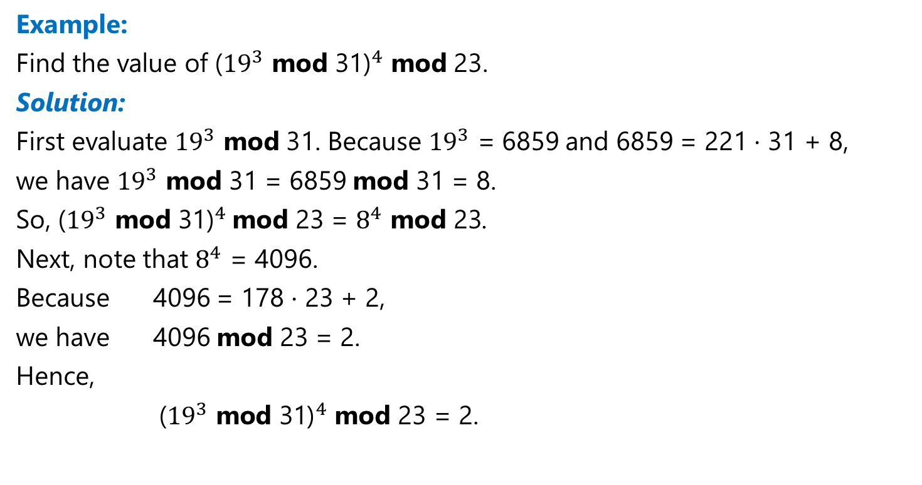
Modular Arithmetic
Example:
Find the value of ${\text{(}{19}^{3} \text{mod} \text{31)}}^{4}$ mod 23.
Solution:
First evaluate ${19}^{3}$ mod 31. Because ${19}^{3}$ = 6859 and 6859 = 221 ⋅ 31 + 8,
we have ${19}^{3}$ mod 31 = 6859 mod 31 = 8.
So, ${\text{(}{19}^{3} \text{mod} \text{31)}}^{4}$mod 23 = $8^{4}$ mod 23.
Next, note that $8^{4}$ = 4096.
Because 4096 = 178 ⋅ 23 + 2,
we have 4096 mod 23 = 2.
Hence,
${ \text{(}{19}^{3} \text{mod} \text{31)}}^{4}$ mod 23 = 2.

Slide 16
Primes and Greatest Common Divisors

Slide 17
Primes
Definition 1
An integer p greater than 1 is called prime if the only positive factors of p are 1 and p. A positive integer that is greater than 1 and is not prime is called composite.
Example :
The integer 7 is prime because its only positive factors are 1 and 7, whereas the integer 9 is composite because it is divisible by 3.

Slide 18
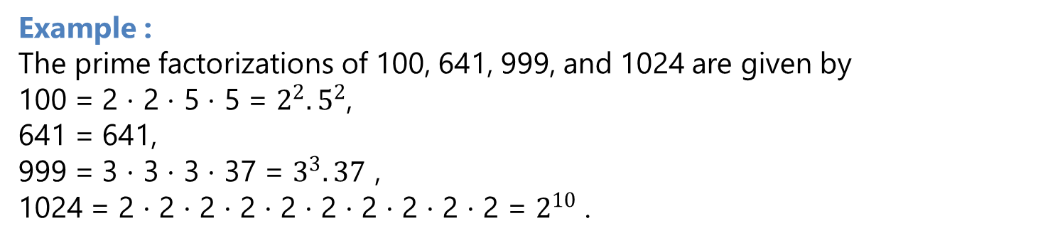
Primes
Theorem 1 .
The Fundamental Theorem Of Arithmetic
Every integer greater than 1 can be written uniquely as a prime or as the product of two or more primes, where the prime factors are written in order of nondecreasing size
Example :
The prime factorizations of 100, 641, 999, and 1024 are given by
100 = 2 ⋅ 2 ⋅ 5 ⋅ 5 = $2^{2}.5^{2}$,
641 = 641,
999 = 3 ⋅ 3 ⋅ 3 ⋅ 37 = $3^{3}.37$ ,
1024 = 2 ⋅ 2 ⋅ 2 ⋅ 2 ⋅ 2 ⋅ 2 ⋅ 2 ⋅ 2 ⋅ 2 ⋅ 2 = $2^{10}$ .

Slide 19
Trial Division
Theorem 2
If n is a composite integer, then n has a prime divisor less than or equal to √n.
Proof:
If n is composite, by the definition of a composite integer, we know that it has a factor a with 1 < a < n.
Hence, by the definition of a factor of a positive integer, we have n = ab, where b is a positive integer greater than 1.
We will show that a ≤√n or b ≤√n. If a >√n and b >√n, then ab >√n ⋅
√n = n, which is a contradiction.
Consequently, a ≤√n orb ≤√n. Because both a and b are divisors of n, we see that n has a positive divisor not exceeding √n.
This divisor is either prime or, by the fundamental theorem of arithmetic, has a prime divisor less than itself. In either case, n has a prime divisor less than or equal to √n.

Slide 20
Trial Division
Example :
Show that 101 is prime.
Solution:
The only primes not exceeding √101 are 2, 3, 5, and 7.
Because 101 is not divisible by 2, 3, 5, or 7
(the quotient of 101 and each of these integers is not an integer),
it follows that 101 is prime.

Slide 21
THE DISTRIBUTION OF PRIMES
Theroem 4.
Theprimenumbertheorem. The ratio of 𝜋(x), the number of primes not exceeding x, and x ∕ ln x approaches 1 as x grows without bound.
(Here ln x is the natural logarithm of x.)
Approximating 𝝅(x) by x /𝐥𝐧 x.

Slide 22
Greatest Common Divisors and Least Common Multiples
Definition 2
Let a and b be integers, not both zero. The largest integer d such that d ∣ a and d ∣ b is called the greatest common divisor of a and b. The greatest common divisor of a and b is denoted by gcd(a, b).
Example :
What is the greatest common divisor of 24 and 36?
Solution:
The positive common divisors of 24 and 36 are 1, 2, 3, 4, 6, and 12.
Hence, gcd(24, 36) = 12.

Slide 23
Greatest Common Divisors and Least Common Multiples
Definition 3
The integers a and b are relatively prime if their greatest common divisor is 1.
Example :
The integers 17 and 22 have no positive common divisors other than 1, so that gcd(17, 22) = 1.
Hence that the integers 17 and 22 are relatively prime.

Slide 24
Greatest Common Divisors and Least Common Multiples
Definition 4
The integers a1, a2,…, an are pairwise relatively prime if gcd(ai, aj) = 1 whenever 1 ≤ i <j ≤ n.
Example :
Determine whether the following integers are pairwise relatively prime
10, 17, and 21
10, 19, and 24
Solution:
a. Because gcd(10, 17) = 1, gcd(10, 21) = 1, and gcd(17, 21) = 1, we conclude that 10,17, and 21 are pairwise relatively prime.
b. Because gcd(10, 24) = 2 > 1, we see that 10, 19, and 24 are not pairwise relatively prime.

Slide 25
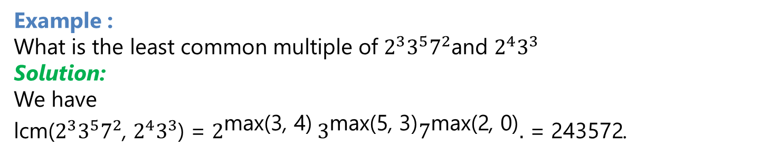
Greatest Common Divisors and Least Common Multiples
Definition 5 :
The least common multiple of the positive integers a and b is the smallest positive integer that is divisible by both a and b. The least common multiple of a and b is denoted by lcm(a, b).
Example :
What is the least common multiple of $2^{3}3^{5}7^{2}$and $2^{4}3^{3}$
Solution:
We have
lcm($2^{3}3^{5}7^{2}$, $2^{4}3^{3}$) = $2^{\text{max}\text{(3}\text{, }\text{4)}}$ $3^{\text{max}\text{(5}\text{, }\text{3)}}7^{\text{max}\text{(2}\text{, }\text{0)}}$ = 243572.
Theorem 5
Let a and b be positive integers. Then ab = gcd(a, b) ⋅ lcm(a, b).

Slide 26
The Euclidean Algorithm
Lemma 1
Let a = bq + r, where a, b, q, and r are integers. Then gcd(a, b) = gcd(b, r).
Proof:
If we can show that the common divisors of a and b are the same as the common divisors of b and r, we will have shown that gcd(a, b) = gcd(b, r), because both pairs must have the same greatest common divisor.
So suppose that d divides both a and b. Then it follows that d also divides
a − bq = r .
Hence, any common divisor of a and b is also a common divisor of b and r.
Likewise, suppose that d divides both b and r. Then d also divides bq + r = a. Hence, any common divisor of b and r is also a common divisor of a and b.
Consequently, gcd(a, b) = gcd(b, r).

Slide 27
The Euclidean Algorithm
Suppose that a and b are positive integers with a ≥ b. Let r0 = a and r1 = b. apply the division algorithm, we obtain
r0 = r1 q1 + r2 0 ≤ r2 < r1,
r1 = r2 q2 + r3 0 ≤ r3 < r2,
⋅⋅⋅
rn−2 = rn−1qn−1 + rn 0 ≤ rn < rn−1,
rn−1 = rn qn.
Furthermore,
it follows from Lemma 1 that
gcd(a, b) = gcd(r0, r1) = gcd(r1, r2) = ⋯ = gcd(rn−2, rn−1)
= gcd(rn−1, rn) = gcd (rn, 0) = rn.

Slide 28
The Euclidean Algorithm
Example :
Find the greatest common divisor of 414 and 662 using the Euclidean algorithm.
Solution:
Successive uses of the division algorithm give:
662 = 414 ⋅ 1 + 248
414 = 248 ⋅ 1 + 166
248 = 166 ⋅ 1 + 82
166 = 82 ⋅ 2 + 2
82 = 2 ⋅ 41.
Hence, gcd(414, 662) = 2, because 2 is the last nonzero remainder.

Slide 29
The Euclidean Algorithm
Pseudocode The Euclidean Algorithm

Slide 30
gcds as Linear Combinations
Theorem 6
Bezout’s Theorem If a and b are positive integers, then there exist integers s and t such that gcd(a, b) = sa + tb.
Definition 6
If a and b are positive integers, then integers s and t such that
gcd(a, b) = sa + tb are called Bezout coefficients of a and b
(after ´ Etienne B´ezout, a French mathematician of the eighteenth century). Also, the equation gcd(a, b) = sa + tb is called Bezout’s identity.
Example :
Express gcd(252, 198) = 18 as a linear combination of 252 and 198 by working backwards through the steps of the Euclidean algorithm.

Slide 31
gcds as Linear Combinations
Solution:
To show that gcd(252, 198) = 18, the Euclidean algorithm uses these divisions:
252 = 198 ⋅ 1 + 54
198 = 54 ⋅ 3 + 36
54 = 36 ⋅ 1 + 18
36 = 18 ⋅ 2 + 0.
We find that
18 = 54 − 1 ⋅ 36.
The second division tells us that
36 = 198 − 3 ⋅ 54.
18 = 54 − 1 ⋅ 36 = 54 − 1 ⋅ (198 − 3 ⋅ 54) = 4 ⋅ 54 − 1 ⋅ 198.
54 = 252 − 1 ⋅ 198.
18 = 4 ⋅ (252 − 1 ⋅ 198) − 1 ⋅ 198 = 4 ⋅ 252 − 5 ⋅ 198,
completing the solution.

Slide 32
gcds as Linear Combinations
Lemma 2
If a, b, and c are positive integers such that gcd(a, b) = 1 and a ∣ bc, then a ∣ c.
Proof:
Because gcd(a, b) =1, by Bezout’s theorem there are integers s and t such that sa + tb = 1.
Multiplying both sides of this equation by c, we obtain sac + tbc = c.
By part (ii ) of that theorem, a ∣ tbc.
Because a ∣ sac and a ∣ tbc, by part (i ) of that theorem, we conclude that a divides sac + tbc.
Because sac + tbc = c, we conclude that a ∣ c.

Slide 33
gcds as Linear Combinations
Lemma 3
If p is a prime and p ∣ a1a2⋯an, where each ai is an integer, then p ∣ ai for some i.
Theorem 7 :
Let m be a positive integer and let a, b, and c be integers. If ac ≡ bc (mod m) and
gcd(c,m) = 1, then a ≡ b (mod m).
Proof:
Because ac ≡ bc (mod m),m ∣ ac − bc = c(a − b). By Lemma 2, because gcd(c,m) = 1, it follows that m ∣ a − b. We conclude that a ≡ b (mod m).

Slide 34
Solving Congruences

Slide 35
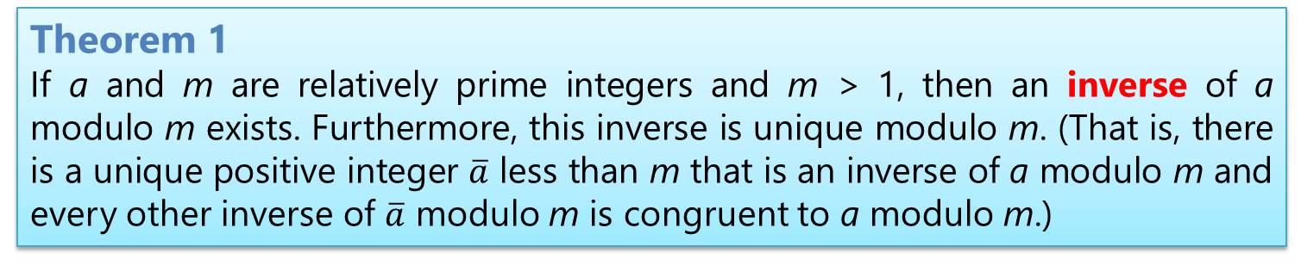
Linear Congruences
Linear congruence : a congruence of the form ax ≡ b (mod m), where m is a positive integer, a and b are integers, and x is a variable.
Theorem 1
If a and m are relatively prime integers and m > 1, then an inverse of a modulo m exists. Furthermore, this inverse is unique modulo m. (That is, there is a unique positive integer $\overline{a}$ less than m that is an inverse of a modulo m and every other inverse of $\overline{a}$ modulo m is congruent to a modulo m.)
Example 1 :
Find an inverse of 3 modulo 7 by first finding Bezout coefficients of 3 and 7. (Note that we have already shown that 5 is an inverse of 3 modulo 7 by inspection.)

Slide 36
Linear Congruences
Solution:
Because gcd(3, 7) = 1, Theorem 1 tells us that an inverse of 3 modulo 7 exists. The Euclidean algorithm ends quickly when used to find the greatest common divisor of 3 and 7:
7 = 2 ⋅ 3 + 1.
From this equation we see that
−2 ⋅ 3 + 1 ⋅ 7 = 1.
This shows that −2 and 1 are Bezout coefficients of 3 and 7.
We see that −2 is an inverse of 3 modulo 7.
Note that every integer congruent to −2 modulo 7 is also an inverse of 3, such as 5, −9, 12, and so on.

Slide 37
Linear Congruences
Example 2
What are the solutions of the linear congruence 3x ≡ 4 (mod 7)?
Solution:
By Example 1 we know that −2 is an inverse of 3 modulo 7.
Multiplying both sides of the congruence by −2 shows that
−2 ⋅ 3x ≡ −2 ⋅ 4 (mod 7).
Because −6 ≡ 1 (mod 7) and −8 ≡ 6 (mod 7),
it follows that if x is a solution, then x ≡ −8 ≡ 6 (mod 7).
Assume that x ≡6 (mod 7).
Then, 3x ≡ 3 ⋅ 6 = 18 ≡ 4 (mod 7),
which shows that all such x satisfy the congruence.
We conclude that the solutions to the congruence are the integers x such that x ≡ 6 (mod 7), namely, 6, 13, 20,… and −1, −8, −15,….

Slide 38
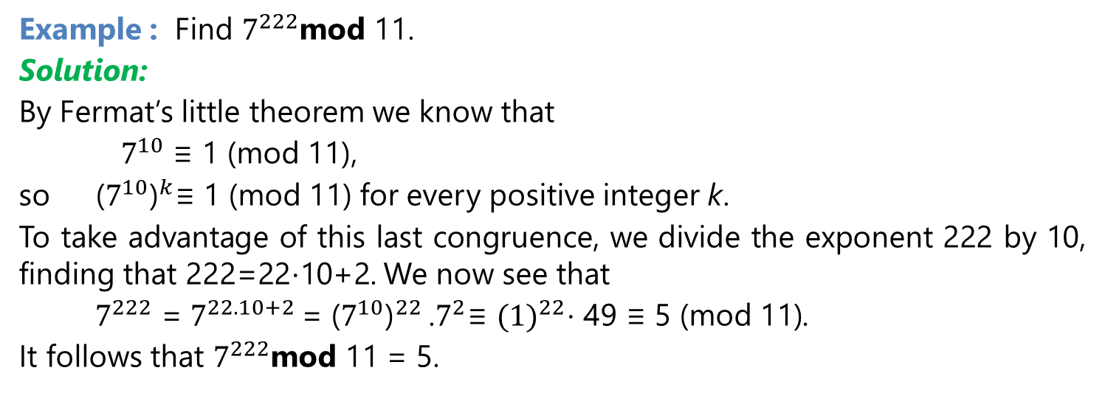
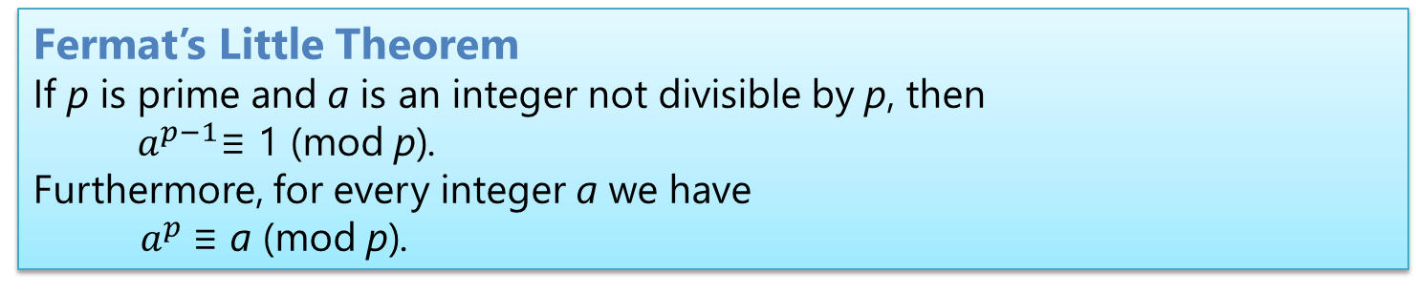
Fermat’s Little Theorem
Fermat’s Little Theorem
If p is prime and a is an integer not divisible by p, then
${ a}^{p−1}$≡ 1 (mod p).
Furthermore, for every integer a we have
${ a}^{p}$≡ a (mod p).
Example : Find $7^{222}$mod 11.
Solution:
By Fermat’s little theorem we know that
$7^{10}$ ≡ 1 (mod 11),
so ${ \text{(}7^{10}\text{)}}^{k}$≡ 1 (mod 11) for every positive integer k.
To take advantage of this last congruence, we divide the exponent 222 by 10, finding that 222=22⋅10+2. We now see that
$7^{222}$ = $7^{22.10+2}$= ${\text{(}7^{10}\text{)}}^{22}$.$7^{2}$≡ ${(1)}^{22}$⋅ 49 ≡ 5 (mod 11).
It follows that $7^{222}$mod 11 = 5.

Slide 39
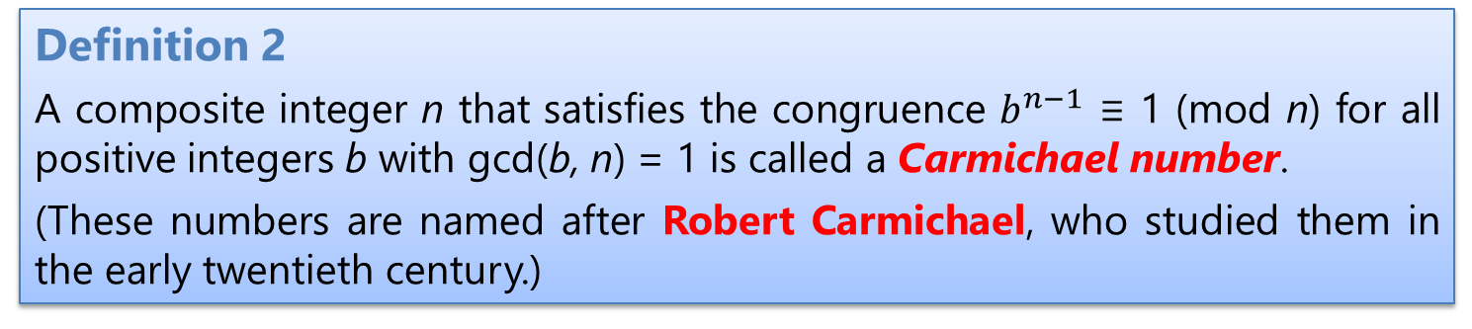
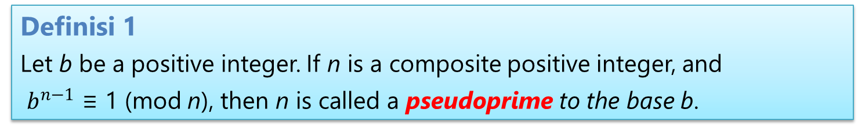
Pseudoprimes
Definisi 1
Let b be a positive integer. If n is a composite positive integer, and
$b^{n−1}$ ≡ 1 (mod n), then n is called a pseudoprime to the base b.
Definition 2
A composite integer n that satisfies the congruence $b^{n−1}$ ≡ 1 (mod n) for all positive integers b with gcd(b, n) = 1 is called a Carmichael number.
(These numbers are named after Robert Carmichael, who studied them in the early twentieth century.)

Slide 40
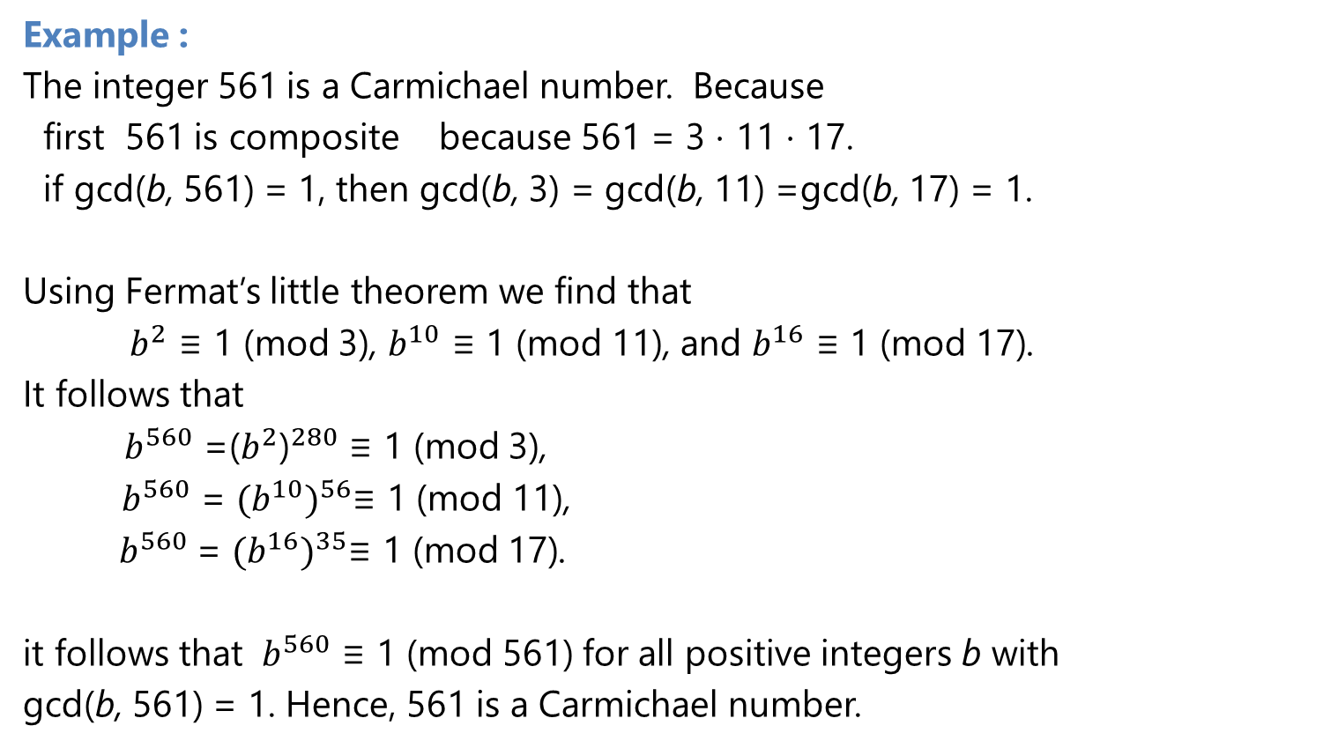
Pseudoprimes
Example :
The integer 561 is a Carmichael number. Because
first 561 is composite because 561 = 3 ⋅ 11 ⋅ 17.
if gcd(b, 561) = 1, then gcd(b, 3) = gcd(b, 11) =gcd(b, 17) = 1.
Using Fermat’s little theorem we find that
${ b}^{2}$ ≡ 1 (mod 3), $b^{10}$ ≡ 1 (mod 11), and $b^{16}$ ≡ 1 (mod 17).
It follows that
$b^{560}$ =${\text{(}b^{2}\text{)}}^{280}$ ≡ 1 (mod 3),
${ b}^{560}$ = ${(b^{10})}^{56}$≡ 1 (mod 11),
${ b}^{560}$= ${(b^{16})}^{35}$≡ 1 (mod 17).
it follows that ${ b}^{560}$ ≡ 1 (mod 561) for all positive integers b with
gcd(b, 561) = 1. Hence, 561 is a Carmichael number.

Slide 41
Applications of Congruences

Slide 42

Applications of Congruences
Congruences have many applications to discrete mathematics, computer science, and many other disciplines.
Three applications in this section:
1. The use of congruences to assign memory locations to computer files,
2. The generation of pseudorandom numbers, and
3. Check digits.

Slide 43
1. Hashing Functions
The central computer at an insurance company maintains records for each of its customers.
Records are identified using a key, which uniquely identifies each customer’s records. For instance, customer records are often identified using the Social Security number of the customer as the key.
A hashing function h assigns memory location h(k) to the record that has k as its key.
a hashing function is not one-to-one, more than one file may be assigned to a memory location. When this happens, we say that a collision occurs. One way to resolve a collision is to assign the first free location following the occupied memory location assigned by the hashing function.
The hashing function h(k) = k mod m, where m is the number of available memory locations

Slide 44
1. Hashing Functions
Example :
Find the memory locations assigned by the hashing function h(k) = k mod 111 to the records of customers with Social Security numbers
a. 064212848
b. 107405723.
Solution:
a. The record of the customer with Social Security number 064212848 is assigned to memory location 14, because
h(064212848) = 064212848 mod 111 = 14.
b. h(107405723) = 107405723 mod 111 = 14,
This location is already occupied (answer a) . But, because memory location 15, the first location following memory location 14, is free, we assign the record of the customer with Social Security number 107405723 to this location.

Slide 45
2. Pseudorandom Numbers
Randomly chosen numbers are often needed for computer simulations.
Pseudorandom numbers : numbers generated by systematic methods are not truly random,
The most commonly used procedure for generating pseudorandom numbers is the linear congruential method. We choose four integers: the modulus m, multiplier a, increment c, and seed x0, with 2 ≤ a < m,
0 ≤ c < m, and 0 ≤ x0 < m
Many computer experiments require the generation of pseudorandom numbers between 0 and 1. To generate such numbers, we use the numbers xn∕m.
We generate a sequence of pseudorandom numbers {xn}, with 0 ≤ xn < m for all n, by successively using the recursively defined function
xn+1 = (axn + c) mod m.

Slide 46
2. Pseudorandom Numbers
Example :
Find the sequence of pseudorandom numbers generated by the linear congruential method with modulus m = 9, multiplier a = 7, increment c = 4, and seed x0 = 3.
Solution:
We compute the terms of this sequence by successively using the recursively defined function xn+1 = (7xn + 4) mod 9,
beginning by inserting the seed x0 = 3 to find x1. We find that
x1 = 7x0 + 4 mod 9 = 7 ⋅ 3 + 4 mod 9 = 25 mod 9 = 7,
x2 = 7x1 + 4 mod 9 = 7 ⋅ 7 + 4 mod 9 = 53 mod 9 = 8,
x3 = 7x2 + 4 mod 9 = 7 ⋅ 8 + 4 mod 9 = 60 mod 9 = 6,
x4 = 7x3 + 4 mod 9 = 7 ⋅ 6 + 4 mod 9 = 46 mod 9 = 1,
x5 = 7x4 + 4 mod 9 = 7 ⋅ 1 + 4 mod 9 = 11 mod 9 = 2,

Slide 47
2. Pseudorandom Numbers
Solution :
x6 = 7x5 + 4 mod 9 = 7 ⋅ 2 + 4 mod 9 = 18 mod 9 = 0,
x7 = 7x6 + 4 mod 9 = 7 ⋅ 0 + 4 mod 9 = 4 mod 9 = 4,
x8 = 7x7 + 4 mod 9 = 7 ⋅ 4 + 4 mod 9 = 32 mod 9 = 5,
x9 = 7x8 + 4 mod 9 = 7 ⋅ 5 + 4 mod 9 = 39 mod 9 = 3.
Because x9 = x0 and because each term depends only on the previous term, we see that the sequence
3, 7, 8, 6, 1, 2, 0, 4, 5, 3, 7, 8, 6, 1, 2, 0, 4, 5, 3,…
is generated.
This sequence contains nine different numbers before repeating.

Slide 48
Check Digits
Congruences are used to check for errors in digit strings.
A common technique for detecting errors in such strings is to add an extra digit at the end of the string.
This final digit, or check digit, is calculated using a particular function. Then, to determine whether a digit string is correct, a check is made to see whether this final digit has the correct value

Slide 49
Check Digits
Example :
Retail products are identified by their Universal Product Codes (UPCs).
The most common form of a UPC has 12 decimal digits: the first digit identifies the product category, the next five digits identify the manufacturer, the following five identify the particular product, and the last digit is a check digit. The check digit is determined by the congruence
3x1 + x2 + 3x3 + x4 + 3x5 + x6 + 3x7 + x8 + 3x9 + x10 + 3x11 + x12
≡ 0 (mod 10).
Answer these questions:
(a) Suppose that the first 11 digits of a UPC are 79357343104. What is the check digit?
(b) Is 041331021641 a valid UPC?

Slide 50
Check Digits
Solution:
We insert the digits of 79357343104 into the congruence for UPC check digits. This gives
3 ⋅ 7 + 9 + 3 ⋅ 3 + 5 + 3 ⋅ 7 + 3 + 3 ⋅ 4 + 3 + 3 ⋅ 1 + 0 + 3 ⋅ 4 + x12
≡ 0(mod 10).
Simplifying, we have
21 + 9 + 9 + 5 + 21 + 3 + 12 + 3 + 3 + 0 + 12 + x12 ≡ 0 (mod 10).
Hence, 98 + x12 ≡ 0 (mod 10).
It follows that x12 ≡ 2 (mod 10),
so the check digit is 2.
To check whether 041331021641 is valid, we insert the digits into the congruence these digits must satisfy. This gives
3 ⋅ 0 + 4 + 3 ⋅ 1 + 3 + 3 ⋅ 3 + 1 + 3 ⋅ 0 + 2 + 3 ⋅ 1 + 6 + 3 ⋅ 4 + 1
≡ 0 + 4 + 3 + 3 + 9 + 1 + 0 + 2 + 3 + 6 + 12 + 1 ≡ 4 ≢ 0 (mod 10).
Hence, 041331021641 is not a valid UPC.

Slide 51
Reference
Kenneth H. Rosen, “ Discrete Mathematics and its Applications”, 8th edition,219, McGraw-Hill Education, New York, ISBN 978-1-259-67651-2

